Slide 1

HKPFS Awardees Reception 2025/26

Slide 2

Today’s Agenda
Welcome Remarks by Prof Lyu Aiping, Vice President (Research & Development) cum Dean of Graduate School
HKPFS Updates by Prof Cheung King-Ho, Executive Associate Dean of Graduate School
3. Awardees’ Sharing
4. Reception and Networking

Slide 3
Welcome Remarks by Prof Lyu Aiping Vice-President (Research and Development) cum Dean of Graduate School

Slide 4
Updates on HKPFS Prof Cheung King-Ho Executive Associate Dean of Graduate School

Slide 5
Updates on Incentive Package

Slide 6
Incentive Package (AY2025/26)
Items | 1st Year | 2nd Year | 3rd Year | 4th Year
*Elite Scholar Award | HK$40,000 | HK$26,000 | HK$26,000 | NA
Monthly Stipend | HK$ 28,400 | HK$ 28,400 | HK$ 28,400 | HK$ 28,400
Tuition Waiver/Scholarship | HK$44,500 | HK$47,000 | HK$49,500 | Amount subject to review
Conference and Research-related Traveling Allowance | HK$14,200 | HK$14,200 | HK$14,200 | NA
HKBU Conference and Research-related Allowance | HK$20,000 throughout 4 years
Guaranteed Shared-room Accommodation | Yes | Yes | NA | NA
*Disbursement of the award will be arranged after the Principal Supervisors’ review of the Bi-annual Progress Report
All incentives are subject to confirmation, change and availability

Slide 7
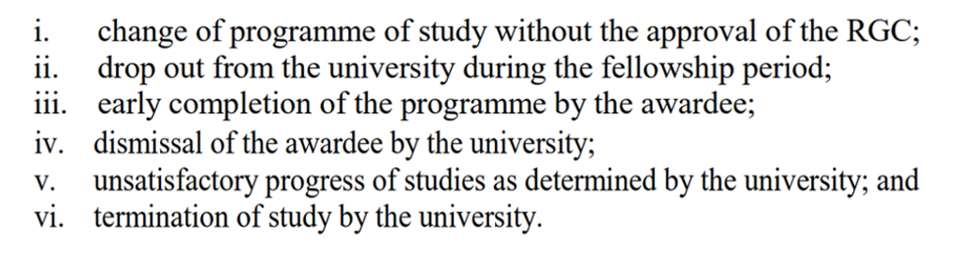
Discontinuation / Termination of Fellowship
The fellowship will be discontinued or terminated in any of the following situations:
Note: Extracted from RGC’s Terms and Conditions for HKPFS awardees

Slide 8
Submission of Annual Report

Slide 9
Annual Report
RGC conducts annual performance evaluations for HKPFS awardees.
Both awardees (year 1-3) and their principal supervisors are required to complete the RGC Annual Report Forms.
Due date: 15 July 2026
5

Slide 10
Leave Application

Slide 11
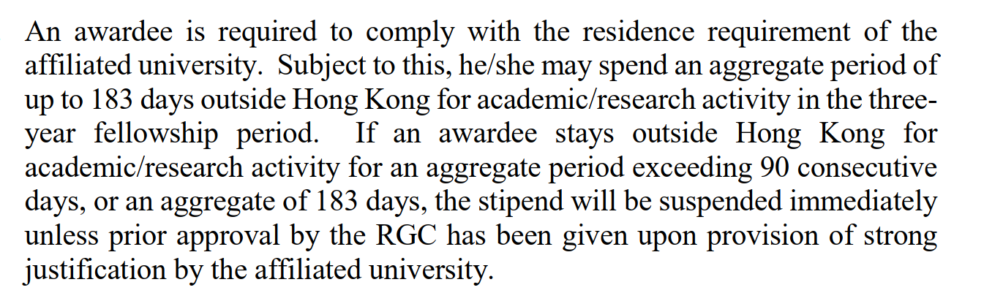
Leave Application
Refer to RGC’s Terms and Conditions for HKPFS awardees.

Slide 12
RGC
Approval

Slide 13
RGC Approval Required For:
What:
Leave exceeding 90 consecutive days or totalling 183 days
Part-time employment
Suspension of studies or changes to fellowship period
Changes to study status or programme
Any substantial changes (consult Graduate School if unsure)

Slide 14
Approval Process
How:
Obtain endorsement from Principal Supervisor, Department Head, and Faculty Dean
Submit request with supporting documents to Graduate School
GS will forward to RGC for approval
Do not commence activity until RGC approval is received

Slide 15
Approval Timeline
When:
All requests should reach the RGC for consideration at least one month before the start of the event.

Slide 16
Featured
HKPFS Graduates

Slide 17
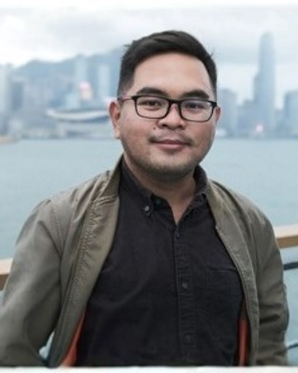
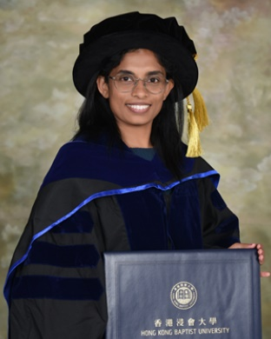
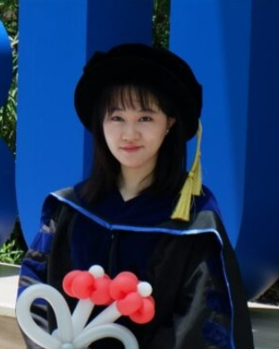
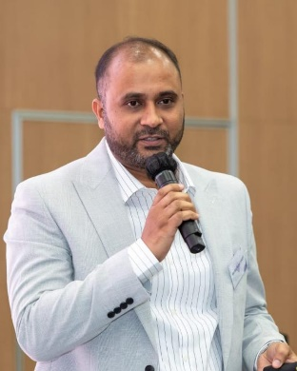
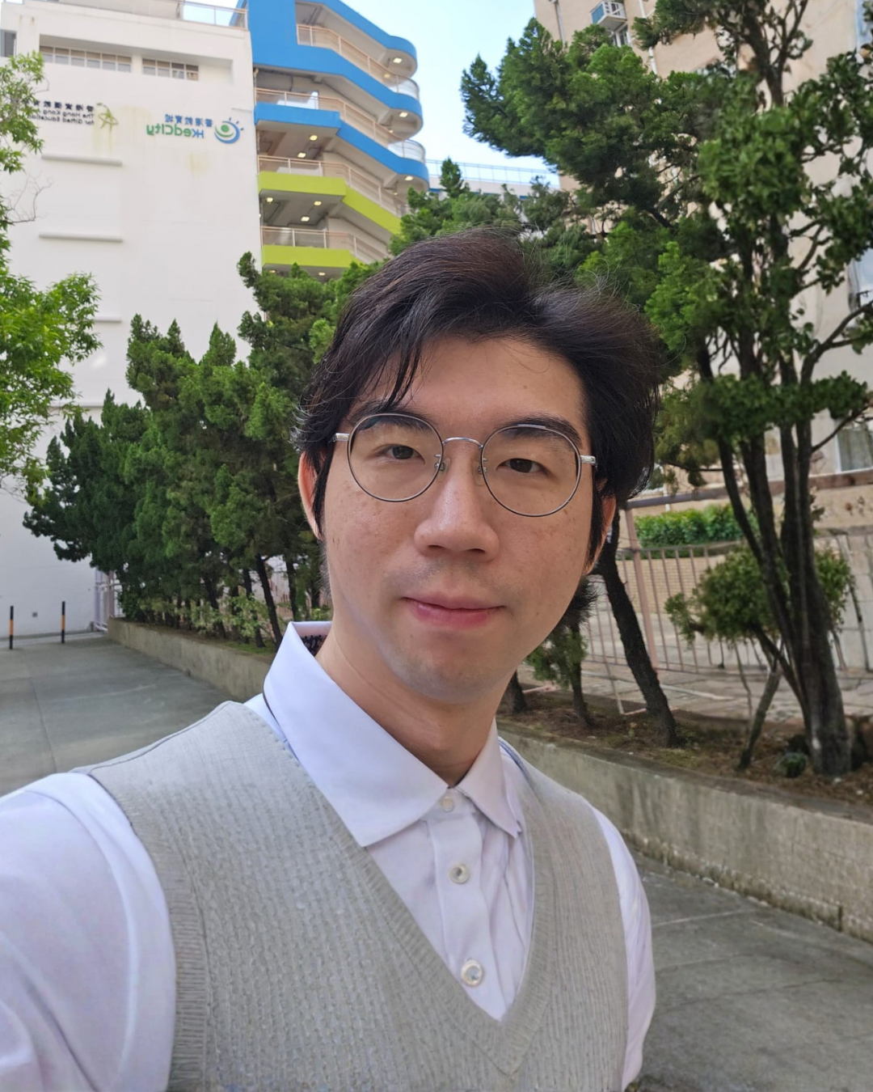
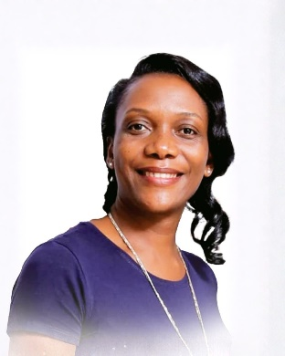
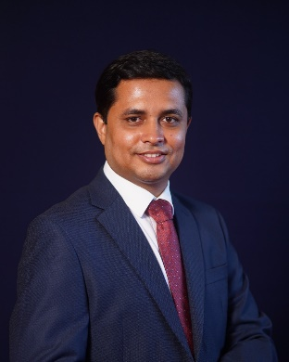
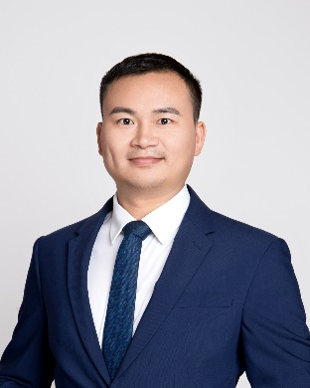
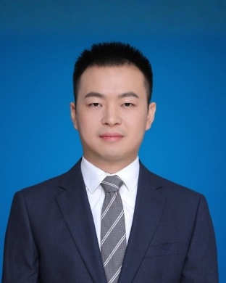
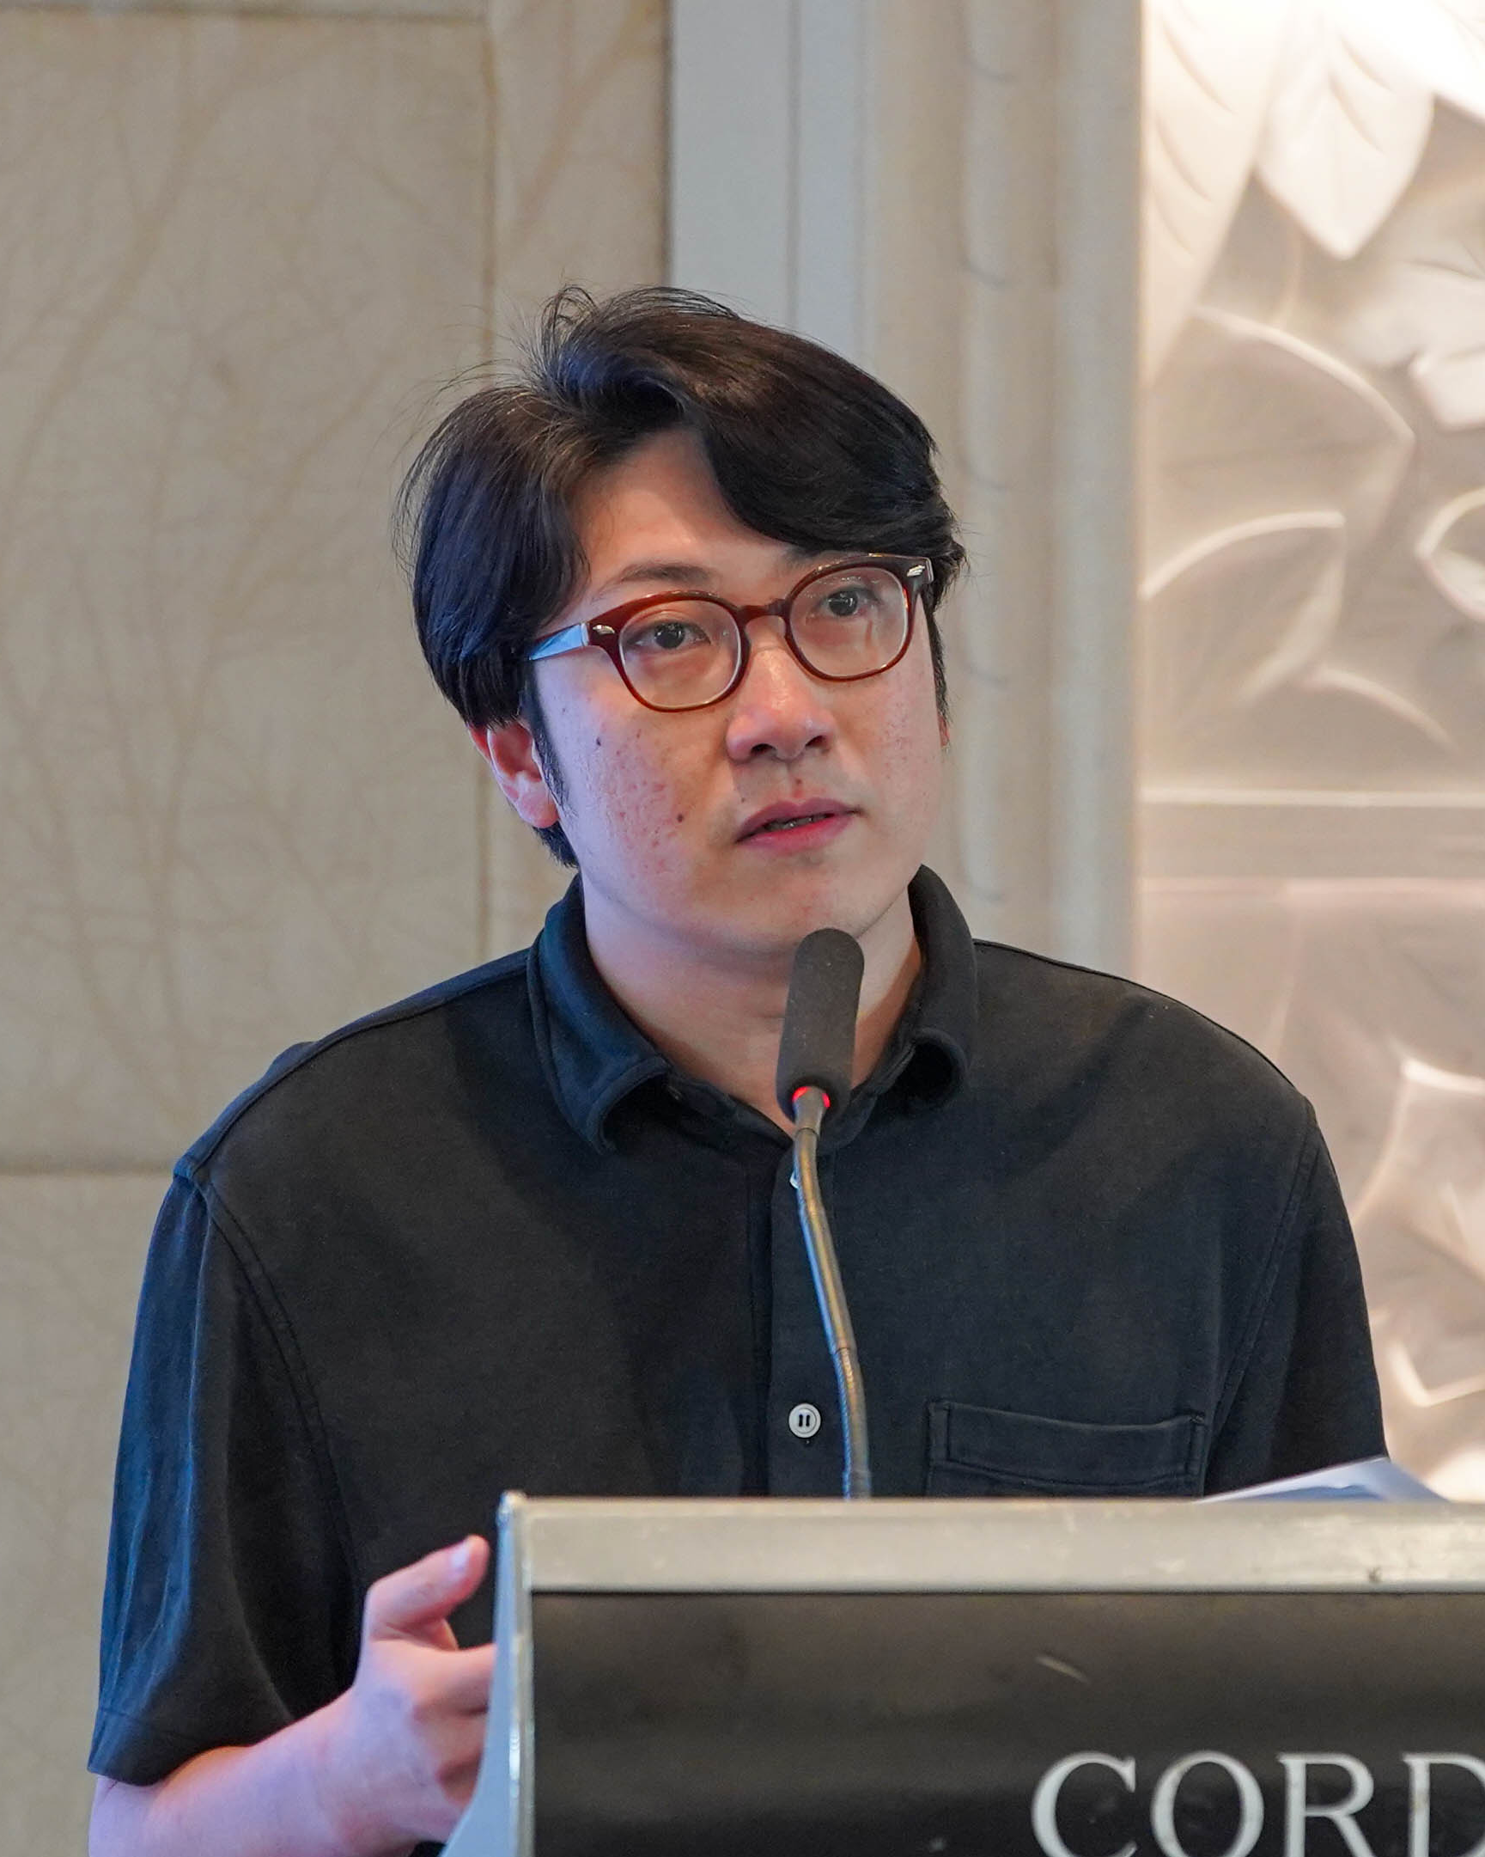
Communication
Sports and Health Sciences
Physics
Communication
Business
CAO Ruepert Jiel Dionisio
Associate Professor, De La Salle University
DEHIWALA LIYANAGE Ishanka Harshani Kusum Peiris
Senior Lecturer, the University of Kelaniya at Sri Lanka
HAO Mingwei
Research Assistant Professor, Hong Kong University of Science and Technology
KABIR Md Ruhul
Associate Professor, Noakhali Science and Technology University
HUNG Tsz Hin
Part-Time Lecturer, Hong Kong Shue Yan University
Communication
Chinese Medicine
Computer Science
Computer Science
Creative Arts
MUGUNGA Ann
Lecturer, Uganda Management Institute
SARWAR Md Shahid
Associate Professor, Noakhali Science and Technology University
SHI Qiquan
AI Researcher, Huawei
YE Mang
Professor, Wuhan University
LI Xiaoqiao
Assistant Professor, Hong Kong Metropolitan University

Slide 18
HKPFS
Ambassadors

Slide 19
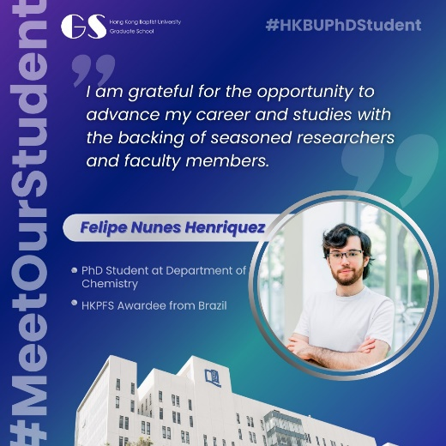

Join Us in Promoting HKBU and HKPFS
Social Media Promotion
Promote GS activities and achievements on your personal social media channels
Media and Promotional Content
Contribute content and be featured in brochures, videos, website and social media
Participate in image photo and video shoots to promote HKBU and HKPFS
Outreach and Engagement
Participate in outreach events and activities (e.g. info sessions, receptions)
Engage with prospective students to share study experiences at HKBU
Foster connections between HKBU and your alma mater institutions

Slide 20

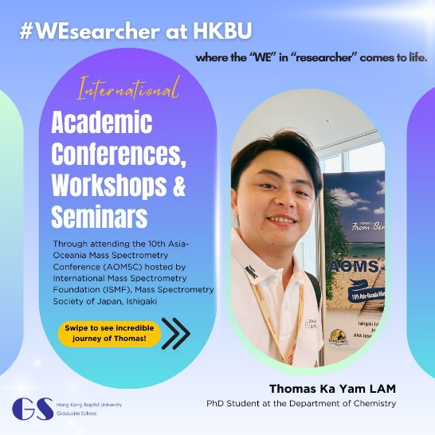
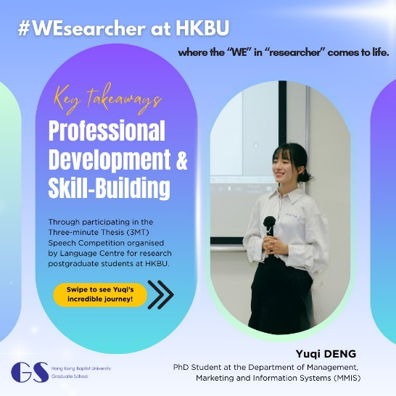

Be a #WEsearcher! Share Your HKBU Story & Get Featured on Graduate School Channels
We invite you to share your unique research and learning journey —whether it’s international adventures, campus triumphs, research breakthroughs, or awards—to spotlight the brilliance of HKBU’s RPg family.
Selected stories will receive $100 coffee coupon as a token of appreciation for enriching our community narrative.
Share Your Story Now!

Slide 21
Thank You

Slide 22
Q&A

Slide 23
HKPFS Awardees Reception 2025/26

